Slide 1
SysEng 5211 Computational Intelligence
Steven Corns
Fuzzy Set Theory

Slide 2
Fuzzy Set Theory
Focuses on nonstatistical uncertainty, not to be confused with statistical uncertainty
Based on set theory and partial memberships

Slide 3
Fuzzy Sets
For example (Bezdek):
You are dying of thirst in a desert and you come across two bottles.
1 has a 91% probability of being potable
2 has a 91% membership in class of potable liquids
What is the difference?

Slide 4
Set Theory
Mathematical theory of how things are grouped together
Uses a fair amount of real analysis notation

Slide 5
Set Theory Symbology from www.rapidtables.com
A ∩ B – A intersection with B
Items belonging to set A and set B
A ∪ B – A Union with B
Items belonging to set A or set B (or both)
The compliment of a set
all elements not in that set
P(A) – Power set of A
All possible subsets of A

Slide 6
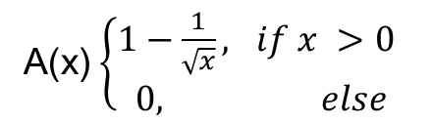
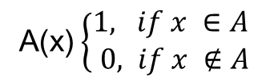
Fuzzy Set Theory
We use a modified set theory for fuzzy systems
Membership is either true or not in set theory
In Fuzzy Sets it varies (large integers):
A(x)$\left\{\begin{matrix}1, if x ∈A \\ 0, if x ∉A\end{matrix} \right.$
A(x)$\left\{\begin{matrix}1−\frac{1}{\sqrt{x}}, if x >\text{0} \\ 0, else\end{matrix} \right.$

Slide 7
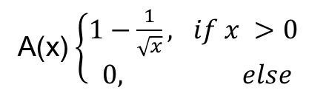
Membership functions
We can see that this describes a membership to a set of large integers
As x increases, so does it’s membership amount, but never exceeds 1
A(x)$\left\{\begin{matrix}1−\frac{1}{\sqrt{x}}, if x >\text{0} \\ 0, else\end{matrix} \right.$

Slide 8
Membership functions
The shape of the membership function should represent how the items fit into the overall system. Common functions are:
Triangular function
Trapezoidal functions
Γ-membership functions
S-membership functions
Logistics Functions
Exponential, Gaussian, etc.

Slide 9
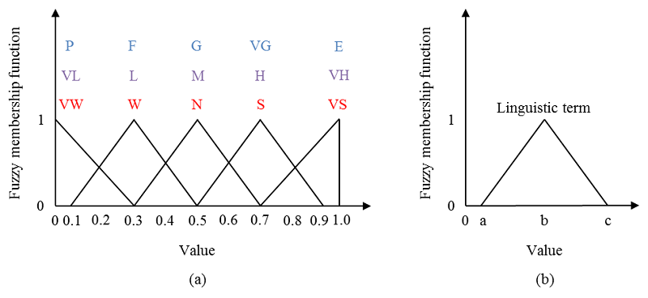
Fuzzy Set Theory
From Lee, Kim, Kim, and Park, “An Agent-Based Competitive Product Diffusion Model for the Estimation and Sensitivity Analysis of
Social Network Structure and Purchase Time Distribution,” Journal of Artificial Societies and Social Simulation, 16(1), 3, 2013.

Slide 10
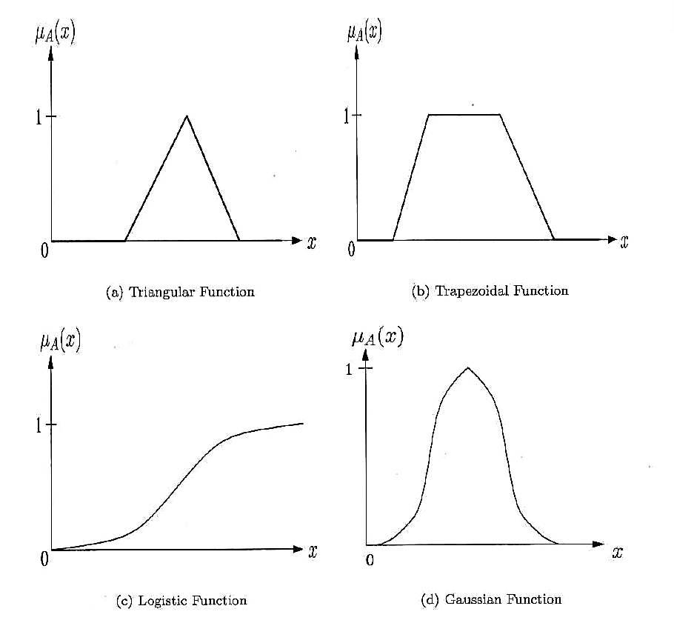
Fuzzy Set Theory
From Engelbrecht, Computational Intelligence: An Introduction, 2nd Ed., John Wiley and Sons Ltd., 2007.

Slide 11
Fuzzy Set Theory
These principles are carried out in Fuzzy systems through the use of:
Operators
Set memberships
Mapping of values from crisp values to partial memberships
Fuzzification and defuzzification
Rule sets

Slide 12
Fuzzy Set Theory Goals
Principle of Least Commitment – Don’t do anything that later must be undone
(originally applied to computer vision; keep options open until you must make a decision)
Principle of Graceful Degradation – An algorithm should deliver partial (and reasonable) answers as input degrades

Slide 13
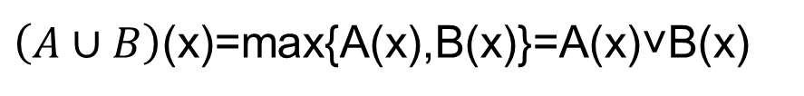
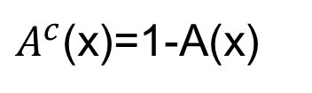
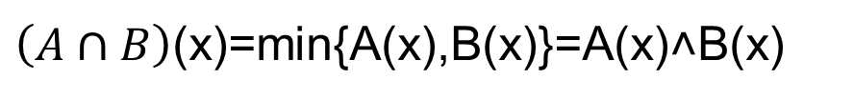
Basic Fuzzy Set Operators (Zadeh, 1965)
The compliment of set A (A^{c}) is:
union
intersect
$A^{c}$(x)=1-A(x)
$\left(A∪B\right)$(x)=max{A(x),B(x)}=A(x)˅B(x)
$\left(A∩B\right)$(x)=min{A(x),B(x)}=A(x)˄B(x)

Slide 14
Basic Fuzzy Set Operators (Zadeh, 1965)
The compliment of set A (A^{c}) is:
union
intersect
Not
$A^{c}$(x)=1-A(x)
Or
$\left(A∪B\right)$(x)=max{A(x),B(x)}=A(x)˅B(x)
$\left(A∩B\right)$(x)=min{A(x),B(x)}=A(x)˄B(x)
And

Slide 15
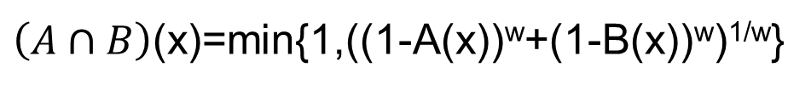
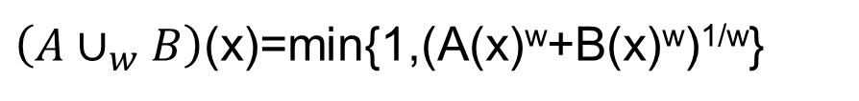
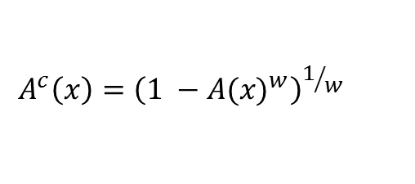
Other operators can also used
Yager (1980) proposed the functions
compliment
union
intersect
$$A^{c}\left(x\right)={\left(1 −A{(x)}^{w}\right)}^{1/w}$$
for w ∈ (0,∞)
$\left(A∪_{w}B\right)$(x)=min{1,(A(x)^{w}+B(x)^{w})^{1/w}}
for w ∈ (0,∞)
$\left(A∩B\right)$(x)=min{1,((1-A(x))^{w}+(1-B(x))^{w})^{1/w}}
for w ∈ (0,∞)

Slide 16
Operators control output results
Yager (1988) used functions similar to this for multicriteria optimization
For example:

Slide 17
Fuzzy Decision Trees
These relationships can be used to make Fuzzy Decision trees
Heart Disease Risk
or
External Factors
Health Related Risks
and
or
Age Risk
Family History Risk
High Blood Pressure Risk
High Cholesterol Risk
Not
Healthy Diet
From Keller, Liu, and Fogel, 2016

Slide 18
Fuzzy Decision Trees
These relationships can be used to make Fuzzy Decision trees
Heart Disease Risk
w₁
External Factors
Health Related Risks
w₂
w₃
w₄
Age Risk
Family History Risk
High Blood Pressure Risk
High Cholesterol Risk
Not
Healthy Diet

Slide 19
Fuzzy Decision Trees
The output risk depends on the parameters. If we used
With inputs of
w1 | w2 | w3 | w4 | Risk
0.5 | 0.5 | 1.0 | 2.0 | 0.7
Age | Family history | High blood pressure | High cholesterol | Healthy diet
0.2 | 0.8 | 0.0 | 0.1 | 0.8

Slide 20
Fuzzy Decision Trees
The output risk would be
Risk = External Factors –or- Health Related Risks
External Factors = Age Risk –and- Family History Risks
Health Related Risks = High Blood Pressure Risk –or- High
Cholesterol Risk –or- (–not- Healthy Diet)

Slide 21
Fuzzy Decision Trees
The output risk would be
Risk = min{1,((1-min{1,((1-0.2)^{w2}+(1-0.8)^{w2})^{1/w2}})^{w1}+
(min{1,((min{1,(0^{w3}+0.1^{w3})^{1/w3}})¹+((1-0.8^{w4})^{1/w4})^{w3})^{1/w3}})^{w1})^{1/w1}}
Risk = min{1,((1-min{1,((1-0.2)^{0.5}+(1-0.8)^{0.5})²})^{0.5}+
(min{1,((min{1,(0¹+0.1¹)^{1/1}})¹+((1-0.8²)^{0.5})¹)^{1/1}})^{0.5})²}=0.7
Risk = min{1,((1-min{1,(0.894+0.447)²})^{0.5}+
(min{1,((min{1,0.1})¹+((0.36)^{0.5})¹)^{1/1}})^{0.5})²}=0.7

Slide 22
Fuzzy Decision Trees
The output risk would be
Risk = min{1,((1-min{1,1.8})^{0.5}+
(min{1,((min{1,0.1})¹+0.6})^{0.5})²}
Risk = min{1,(1-1)^{0.5}+
(min{1,(0.1+0.6})^{0.5})²}=0.7
Risk = 0+0.7=0.7

Slide 23
Fuzzy Relations and Fuzzy Logic Inference
Fuzzy decision functions are best described in terms of linguistic rules:
IF External Factor Risk is SOMEWHAT LOW
AND
Health Related Risk is LOW
THEN
Overall Heart Disease Risk is LOW

Slide 24
Fuzzy Relations and Fuzzy Logic Inference
This requires some level of domain knowledge
Linguistic variables are created from the underlying domain
Domain will drive the variable name
Problem may drive the number of values

Slide 25
Linguistic variables
For example
for the Linguistic variable ‘age’
‘infant’, ‘young’, ‘adult’, ‘middle’, ‘senior’, and ‘elderly’
These values would range from 0 to 1, with distributions dependent on SME input

Slide 26
Fuzzy Relations and Propositions
In crisp set theory, relations describe a mapping between two domains:
Eg. cities with airports
New York has two airports:
Laguardia
JFK
For a given location, would either be acceptable?

Slide 27
Fuzzy Relations and Propositions - Hedges
Some atomic propositions can still be limited
Hedges are often used to modify the linguistic terms

Slide 28
Hedges
Hedges can apply conditions, set truth values and/or probabilities
Eg. NOT, SOMEWHAT, MORE_OR_LESS, VERY, RATHER, QUITE

Slide 29
Hedges
This gives a wider range of values to work with, using modifiers, such as
‘NOT’ would use the compliment operator
‘VERY’ my modify ‘YOUNG’ by squaring the value
‘MORE_OR_LESS’ may take the square root
Using this, we get: ‘VERYYoung(x)<Young(x)<MORE_OR_LESSYoung(x)

Slide 30
Fuzzy Relations and Propositions
Conjunctive Proposition:
U₁ is A₁ and U₂ is A₂
Propositions are the basis for fuzzy inferencing
Depending on how these relate different ‘responses’ are provided

Slide 31
Fuzzy Relations and Propositions
Conjunctive Proposition:
U₁ is A₁ and U₂ is A₂
This results in a cross-product based on U₁ and U₂.
Called the cylindrical closure of the fuzzy sets A₁ and A₂

Slide 32
Cylindrical Closure
Suppose X₁={1,2,3,4}, X₂={$,@,&}.
If A₁=SMALL=1.0/1+0.8/2+0.0/3+0.0/4 and A₂=Large=0.0/$+0.6/@+1.0/&, then the meaning of the proposition U₁ is A₁ and U₂ is A₂ is the cylindrical closure of A₁ and A₂ in X₁ x X₂.

Slide 33

Cylindrical Closure
X1={1,2,3,4}, X2={$,@,&}
A₁=SMALL=1.0/1+0.8/2+0.0/3+0.0/4
A₂=Large=0.0/$+0.6/@+1.0/&
_{(using a min operator)}
A₁ x A₂ = $\left(\begin{matrix}\begin{matrix}0.0 \\ 0.0\end{matrix} & \begin{matrix}0.6 & 1.0 \\ 0.6 & 0.8\end{matrix} \\ \begin{matrix}0.0 \\ 0.0\end{matrix} & \begin{matrix}0.0 & 0.0 \\ 0.0 & 0.0\end{matrix}\end{matrix}\right)$

Slide 34
Fuzzy Relations and Propositions
Condition Proposition (Fuzzy Implication):
IF U is A THEN V is B
Where U and V are linguistic variables with elements
x ∈ X and y ∈Y respectively
And
A(x) and B(y) are linguistic values represented by fuzzy sets on those elements

Slide 35
Fuzzy Relations
Condition Proposition (Fuzzy Implication):
This is a fuzzy relation R between X and Y, based on U and V
This can also involves multiple operators

Slide 36
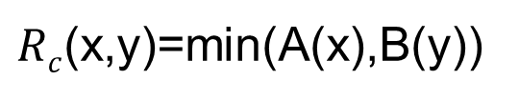
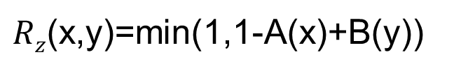
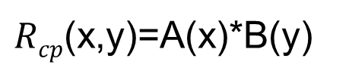
Example Definitions (Klir and Yuan, 1995)
Lukasiewicz implication (Zadeh’s original)
Correlation min implication
Correlation product implication
$Rz$(x,y)=min(1,1-A(x)+B(y))
$Rc$(x,y)=min(A(x),B(y))
$Rcp$(x,y)=A(x)*B(y)

Slide 37
Fuzzy Relations
Suppose X={1,2,3,4}, Y={a,b,c,d,e}.
If A=SMALL=1.0/1+0.8/2+0.0/3+0.0/4 and B=MEDIUM=0.0/a+0.5/b+1.0/c+0.5/d+0.0/e
For the rule If U is SMALL then V is MEDIUM
We can solve an individual pair by treating the sets as vectors

Slide 38
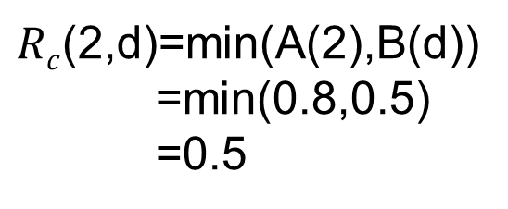
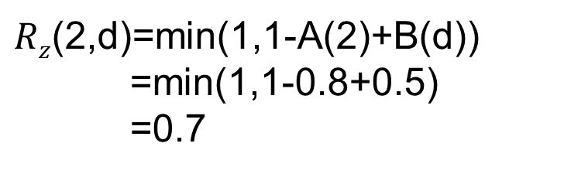
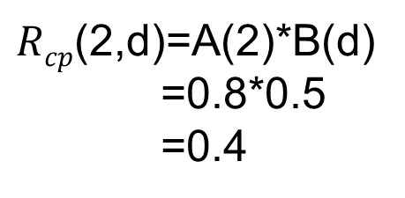
Fuzzy Relations
$Rz$(2,d)=min(1,1-A(2)+B(d))
=min(1,1-0.8+0.5)
=0.7
$Rc$(2,d)=min(A(2),B(d))
=min(0.8,0.5)
=0.5
$Rcp$(2,d)=A(2)*B(d)
=0.8*0.5
=0.4

Slide 39
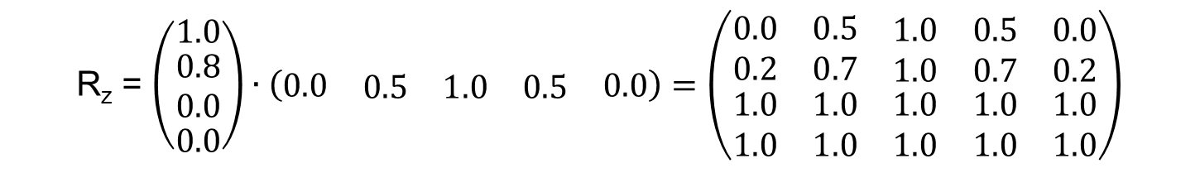
Fuzzy Relations
This can be done for all of the values to visualize the results
R_{z} = $\left(\begin{matrix}1.0 \\ \begin{matrix}0.8 \\ 0.0\end{matrix} \\ 0.0\end{matrix}\right)∙\left(\begin{matrix}0.0 & \begin{matrix}0.5 & 1.0 & 0.5\end{matrix} & 0.0\end{matrix}\right)=\left(\begin{matrix}0.0 & 0.5 & \begin{matrix}1.0 & 0.5 & 0.0\end{matrix} \\ 0.2 & 0.7 & \begin{matrix}1.0 & 0.7 & 0.2\end{matrix} \\ \begin{matrix}1.0 \\ 1.0\end{matrix} & \begin{matrix}1.0 \\ 1.0\end{matrix} & \begin{matrix}\begin{matrix}1.0 & 1.0 & 1.0\end{matrix} \\ \begin{matrix}1.0 & 1.0 & 1.0\end{matrix}\end{matrix}\end{matrix}\right)$

Slide 40
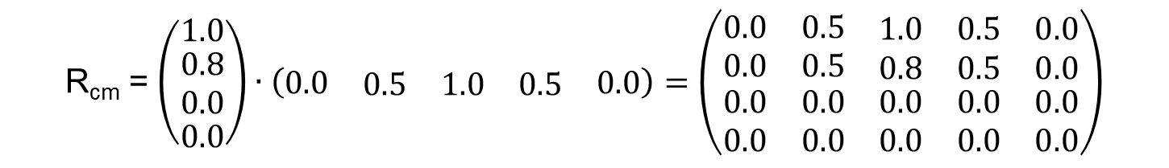
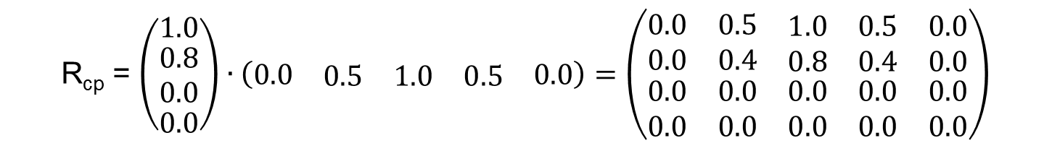
Fuzzy Relations
R_{cm} = $\left(\begin{matrix}1.0 \\ \begin{matrix}0.8 \\ 0.0\end{matrix} \\ 0.0\end{matrix}\right)∙\left(\begin{matrix}0.0 & \begin{matrix}0.5 & 1.0 & 0.5\end{matrix} & 0.0\end{matrix}\right)=\left(\begin{matrix}0.0 & 0.5 & \begin{matrix}1.0 & 0.5 & 0.0\end{matrix} \\ 0.0 & 0.5 & \begin{matrix}0.8 & 0.5 & 0.0\end{matrix} \\ \begin{matrix}0.0 \\ 0.0\end{matrix} & \begin{matrix}0.0 \\ 0.0\end{matrix} & \begin{matrix}\begin{matrix}0.0 & 0.0 & 0.0\end{matrix} \\ \begin{matrix}0.0 & 0.0 & 0.0\end{matrix}\end{matrix}\end{matrix}\right)$
R_{cp} = $\left(\begin{matrix}1.0 \\ \begin{matrix}0.8 \\ 0.0\end{matrix} \\ 0.0\end{matrix}\right)∙\left(\begin{matrix}0.0 & \begin{matrix}0.5 & 1.0 & 0.5\end{matrix} & 0.0\end{matrix}\right)=\left(\begin{matrix}0.0 & 0.5 & \begin{matrix}1.0 & 0.5 & 0.0\end{matrix} \\ 0.0 & 0.4 & \begin{matrix}0.8 & 0.4 & 0.0\end{matrix} \\ \begin{matrix}0.0 \\ 0.0\end{matrix} & \begin{matrix}0.0 \\ 0.0\end{matrix} & \begin{matrix}\begin{matrix}0.0 & 0.0 & 0.0\end{matrix} \\ \begin{matrix}0.0 & 0.0 & 0.0\end{matrix}\end{matrix}\end{matrix}\right)$

Slide 41
Fuzzy Relations
Keep in mind, this is for visualization, if there were more than one relation then dimensionality becomes cumbersome
If U₁ is SMALL and U₂ is LARGE Then V is MEDIUM
_{Creates a 4X3X5 matrix…}

Slide 42
Fuzzy Logic Inference
Fuzzy implications propositions are just fuzzy rules
Now we need to combine the fuzzy rule and linguistic proposition

Slide 43
Fuzzy Logic Inference
Rule: If U is A then V is B
Fact: U is Aꞌ
Conclusion: V is Bꞌ

Slide 44

Fuzzy Logic Inference
This requires a composition operation:
Then the composition operator is:
$$Bꞌ\left(y\right)=Aꞌ(x)°R(x,y)$$
$Bꞌ\left(y\right)=Aꞌ\left(x\right)°R\left(x,y\right)= \begin{matrix}sup \\ x∈X\end{matrix}{min}\{Aꞌ\left(x\right),R\left(x,y\right)$}

Slide 45
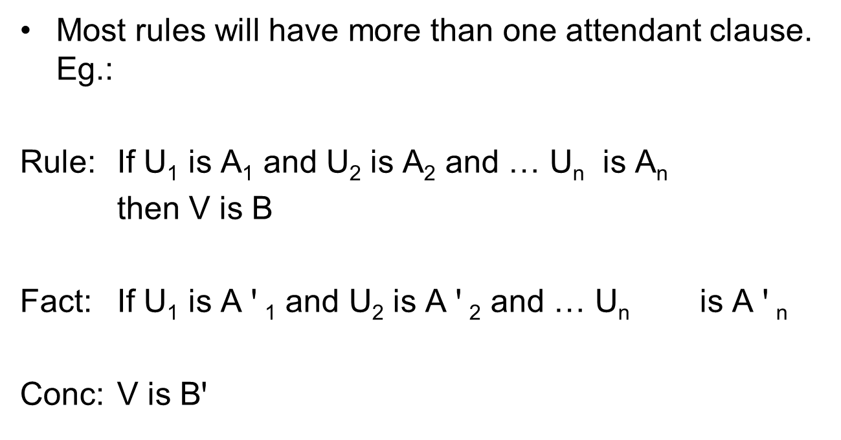
Fuzzy Logic Inference
Most rules will have more than one attendant clause. Eg.:
Rule: If U₁ is A₁ and U₂ is A₂ and … U_{n} is A_{n}
then V is B
Fact: If U₁ is A $ꞌ$₁ and U₂ is A $ꞌ$₂ and … U_{n} is A $ꞌ$_{n}
Conc: V is Bꞌ

Slide 46
Fuzzy Logic Inference
To solve this, you would fist find the cylindrical closure of A₁xA₂x…xA_{n} for all n clauses
This gives a fuzzy relation R between X₁xX₂x…xX_{n} and Y
And so the conclusion can be drawn from the inference:
$$Bꞌ\left(y\right)=Aꞌ1x…xAꞌn1(x1,…,xn)°R(x1,…,xn,y)$$

Slide 47
Fuzzy Logic Inference
To solve this, you would fist find the cylindrical closure of A₁xA₂x…xA_{n} for all n clauses
This gives a fuzzy relation R between X₁xX₂x…xX_{n} and Y
And so the conclusion can be drawn from the inference:
$$Bꞌ\left(y\right)=Aꞌ1x…xAꞌn1(x1,…,xn)°R(x1,…,xn,y)$$

Slide 48
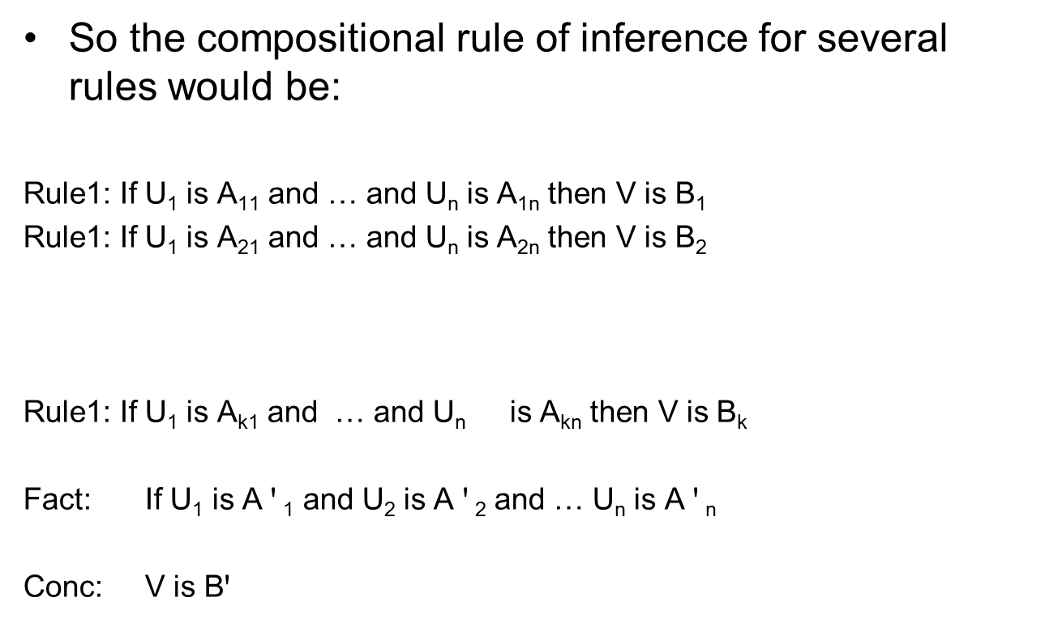
Fuzzy Logic Inference
So the compositional rule of inference for several rules would be:
Rule1: If U₁ is A₁₁ and … and U_{n} is A_{1n} then V is B₁
Rule1: If U₁ is A₂₁ and … and U_{n} is A_{2n} then V is B₂
Rule1: If U₁ is A_{k1} and … and U_{n} is A_{kn} then V is B_{k}
Fact: If U₁ is A $ꞌ$₁ and U₂ is A $ꞌ$₂ and … U_{n} is A $ꞌ$_{n}
Conc: V is Bꞌ
.
.
.

Slide 49
Fuzzy Logic Inference
Each of these rules is translated to form R(x₁,…,x_{n},y), and then apply the compositional rule of inference:
This provides a group of partial solutions
$$Bꞌi\left(y\right)=Aꞌi1x…xAꞌin1(x1,…,xn)°Ri(x1,…,xn,y)$$

Slide 50

Fuzzy Logic Inference
The partial solutions can be aggregated into a single output fuzzy set using either
Or _{k}
$$Bꞌ\left(y\right)=\sum_{i=1}^{k}{Bꞌi\left(y\right)}$$
$$Bꞌ\left(y\right)=\max_{i=1}\left\{Bꞌi\left(y\right)\right\}$$

Slide 51

Defuzzification
In many instances, this output fuzzy set needs to be converted into a single numeric value
This is done through a defuzzification process.
Eg. Centroid method:
$$\overline{y}=\frac{\sum_{y∈Y}{y∙Bꞌ\left(y\right)}}{\sum_{y∈Y}{Bꞌ\left(y\right)}}$$

Slide 52
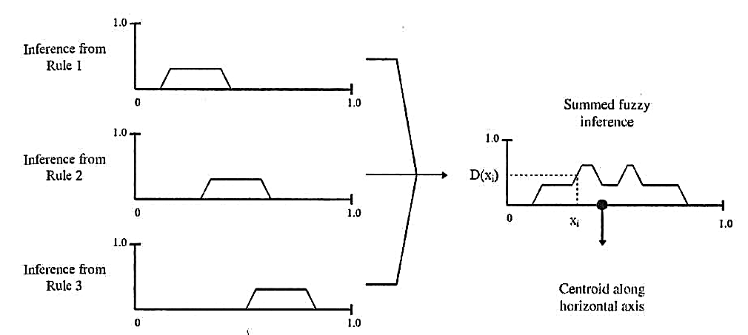
Defuzzification
Graphically, this looks like…

Slide 53
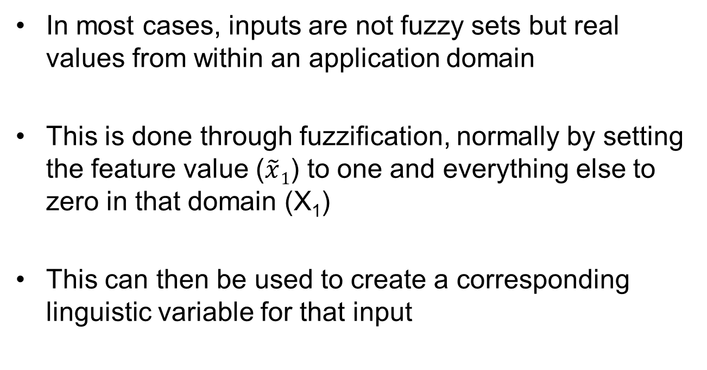
Fuzzy for Real-valued inputs
In most cases, inputs are not fuzzy sets but real values from within an application domain
This is done through fuzzification, normally by setting the feature value ($\tilde{x}1$) to one and everything else to zero in that domain (X₁)
This can then be used to create a corresponding linguistic variable for that input

Slide 54
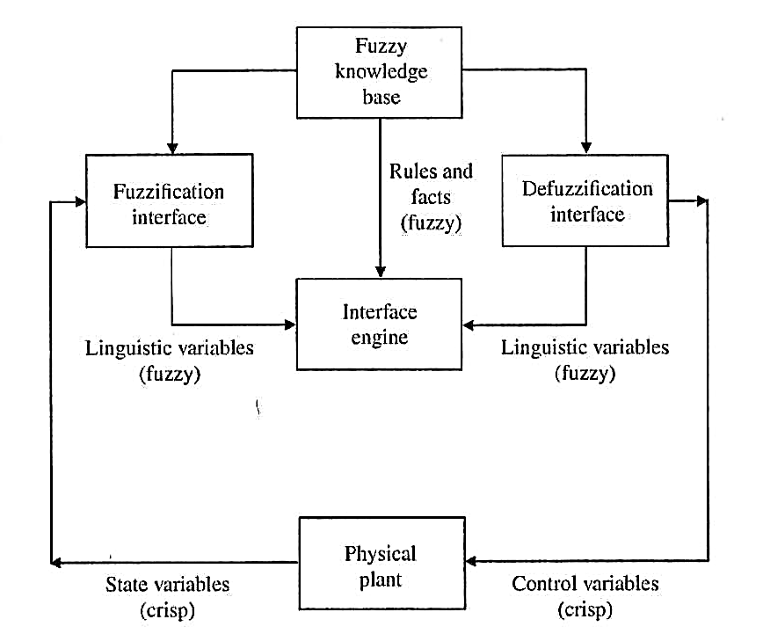
“Standard” Fuzzy Logic Controller
From Keller, Liu, and Fogel, 2016

Slide 55
Where do the rules come from?
Rules usually come from expert input
Fuzzy rules can also be learned if there is sufficient training data
Supervised learning

Slide 56
And the answer is…
42

Slide 57
Moving Forward
Next week:
Neural networks
Maybe a video presentation of Paul Werbos
And then:
Applications in Numerical Analysis

Slide 58
Program Completed
Missouri University of Science & Technology
© 2003 Curators of University of Missouri

